Slide 1
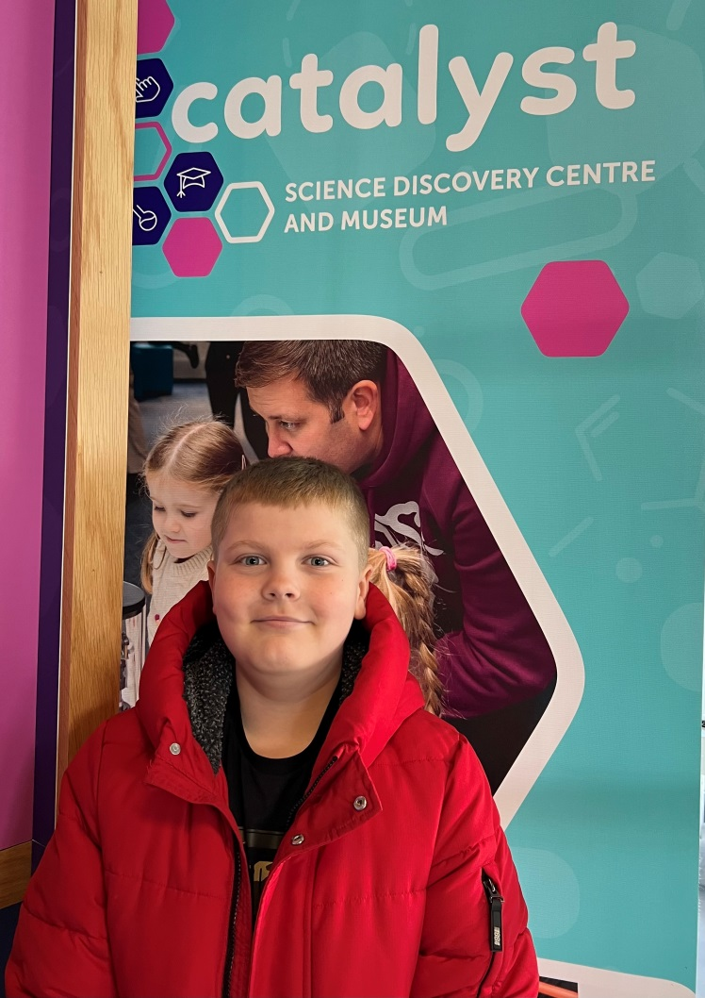
Catalyst Science Discovery Centre and Museum

Slide 2
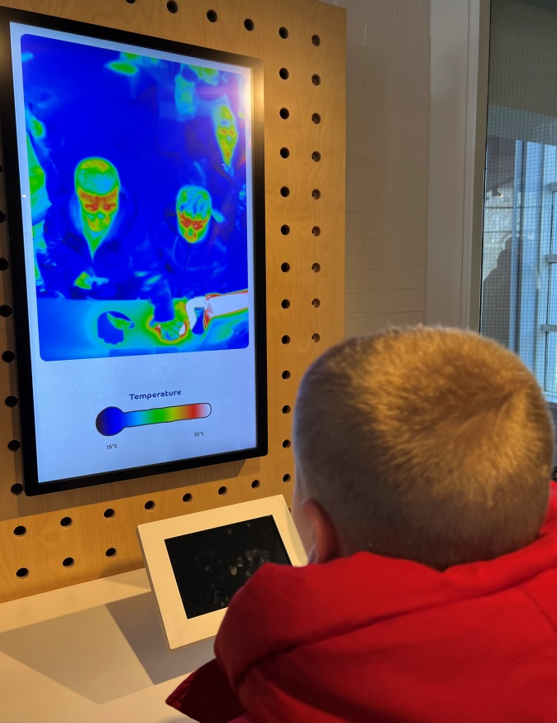
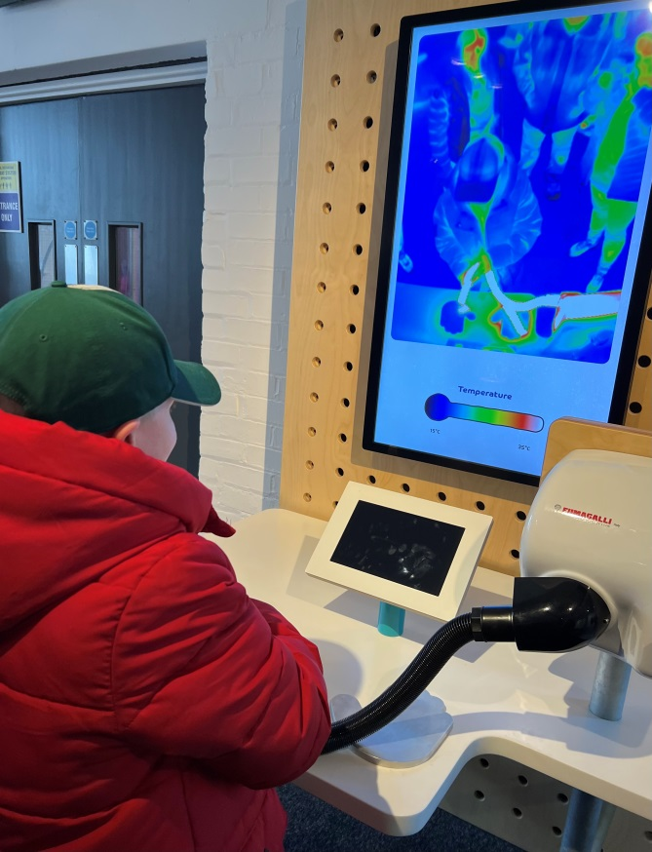
Heat Scan
The machines scanned our body temperature. I added heat by using a dryer.

Slide 3
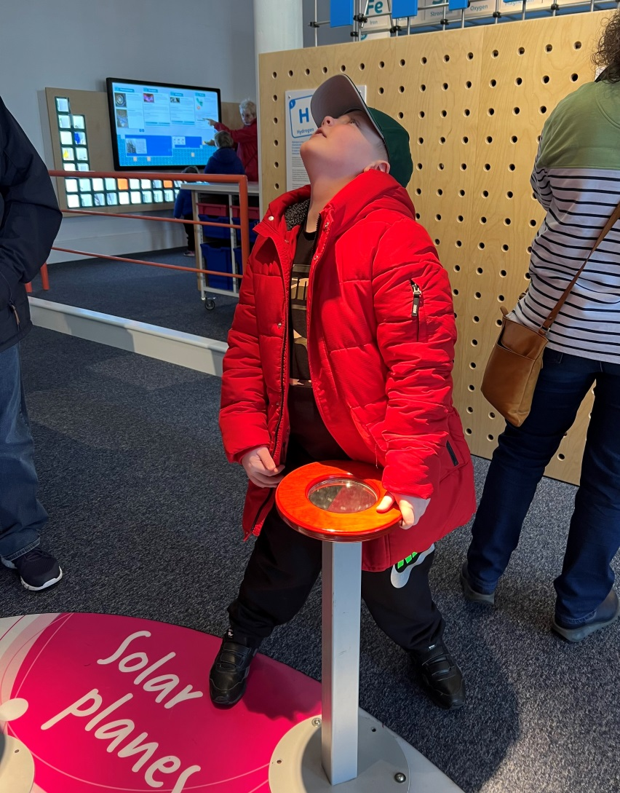
Solar Planes
I used a mirror with a light shining on it to power a plane above.
This is using solar energy to power a machine.

Slide 4
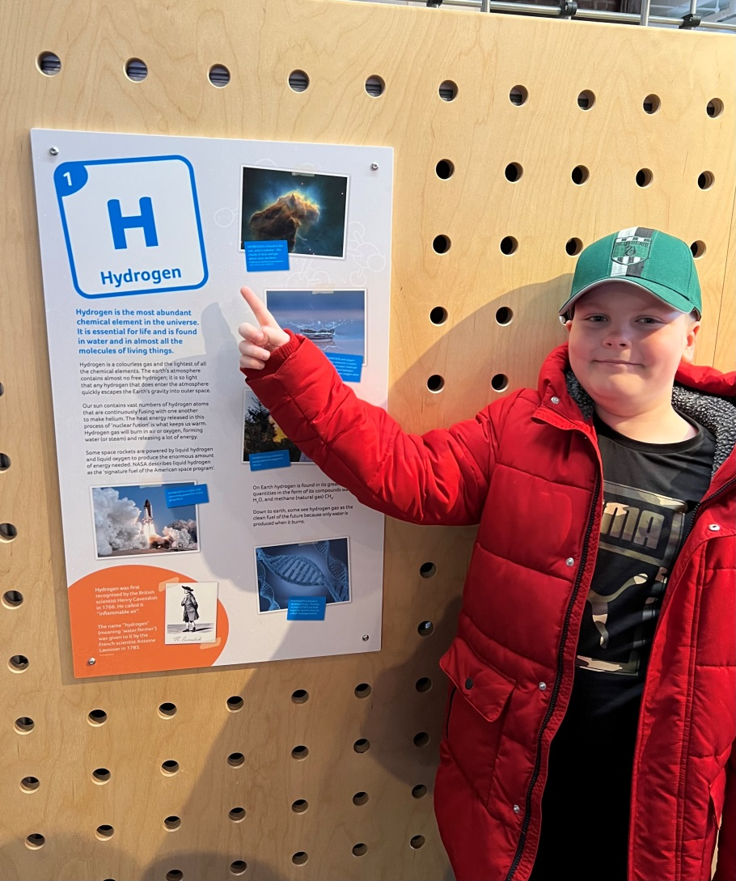
Periodic Table
There was a large periodic table on the floor.
Then posters with individual elements on like this one for Hydrogen.

Slide 5
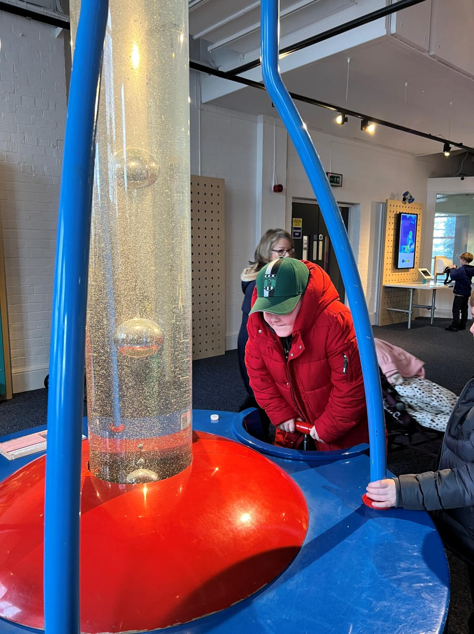
Bubble Tube
Pump bubbles into the tube and watch them rise.
Bubbles travel slowly as oil is quite thick (viscous) and acts as a drag on anything moving through it.
The smaller the bubble the slower it goes, they speed up as they rise as the pressure is lower.
When big bubbles catch up with small ones they combine.

Slide 6
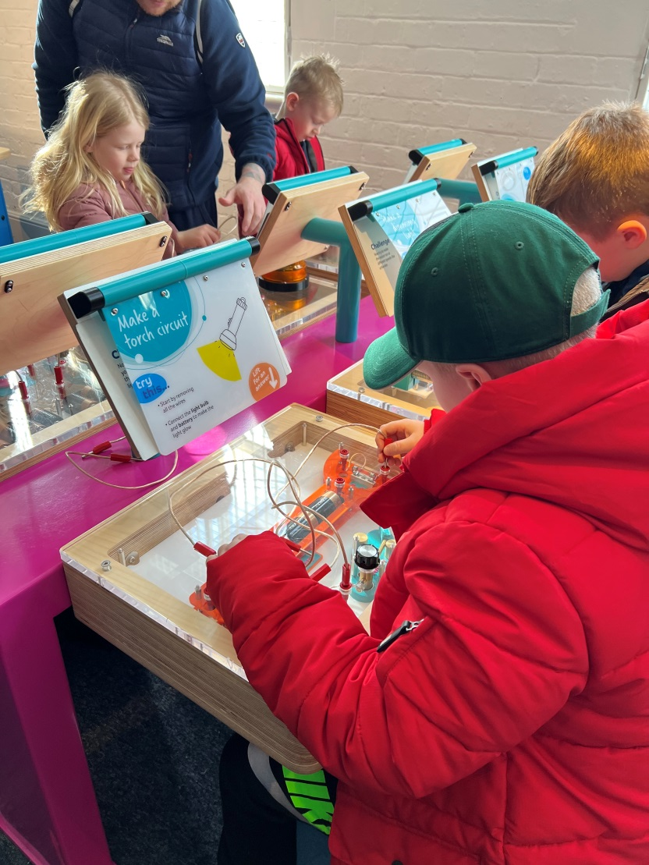
Electrical Circuits
I put wires in little holes then the lights turned on.
After that I went on to the next one, this time it had a light and a motor.

Slide 7
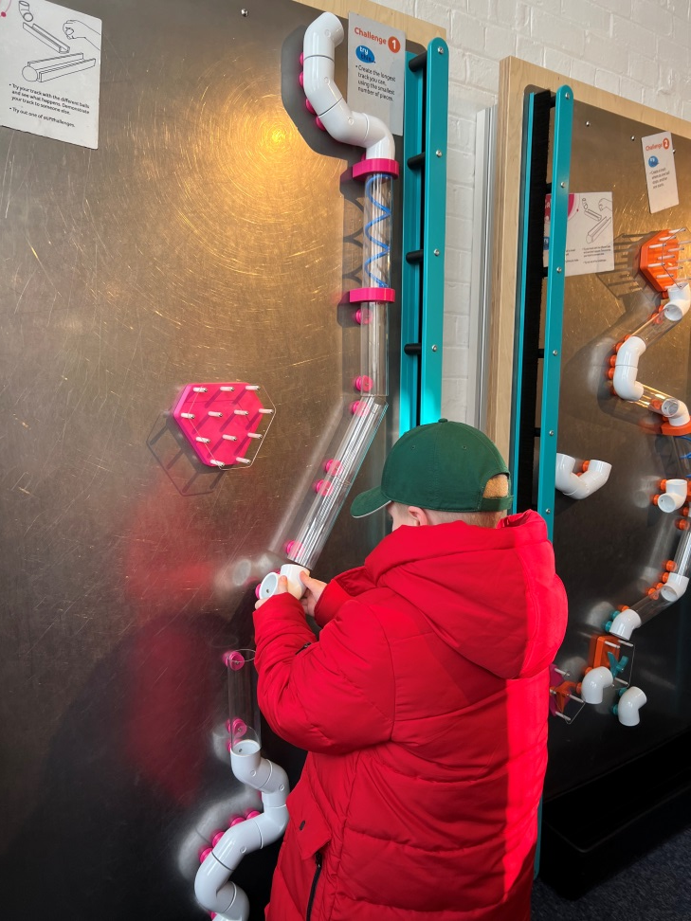
Ball Puzzle
My friend did one of these and I changed it instead I rotated the straight bit to make it like a turn.
AND IT WORKED!

Slide 8
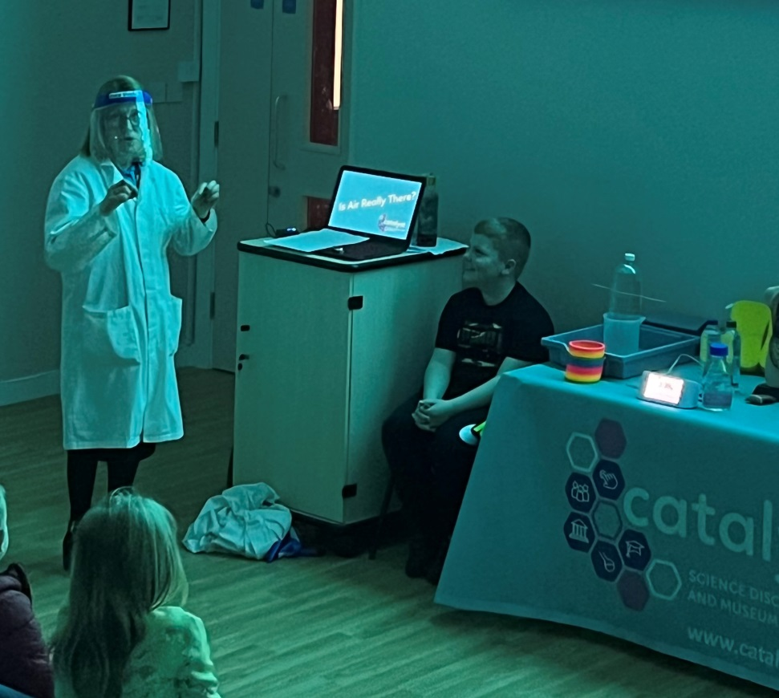
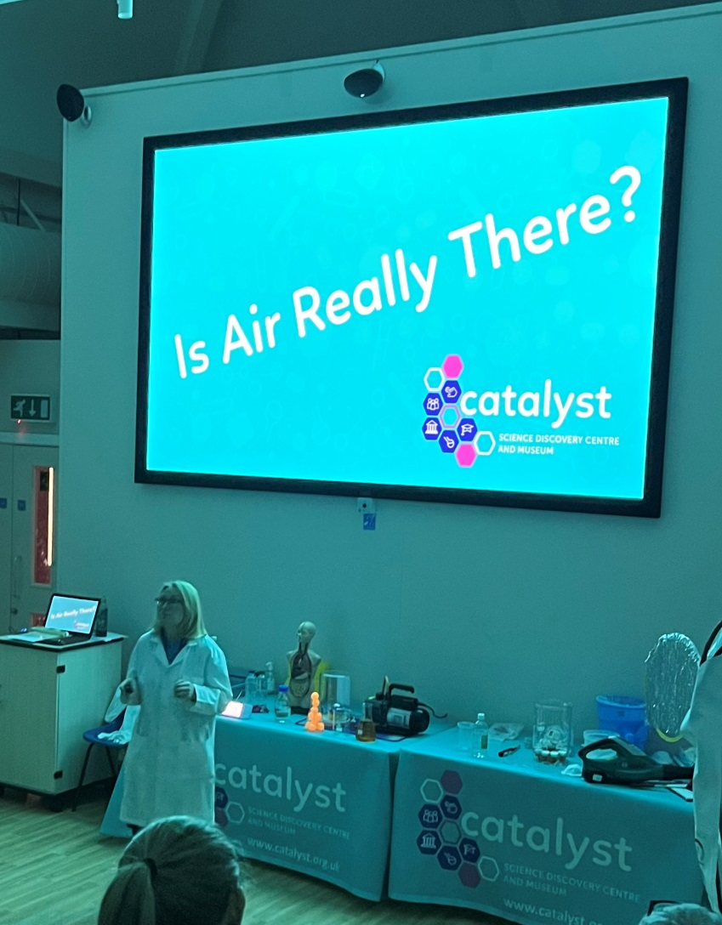
Is Air Really There?
I volunteered to take part in an experiment.

